Slide 1

WELCOME BACK TO
MONEY BASICS
Facilitated by:
[Facilitator 1 name]
[Facilitator 2 name]

Slide 2
Savings Accounts & Savings Goals
Workshop 10
PG. 170 IN STUDENT GUIDE

Slide 3
Welcome Back!
Updates & Sharing:
How did the money saving homework go?
How are your budgets going?
Did you identify any purchases or goals you’d like to start saving for?
Today’s Agenda:
Learn about savings accounts, how they are insured, how we can earn interest on our savings, and the different types available.
Learn about the different types of retirement accounts available, and the time frame and investments associated with them.
Learn about asset building, paying special attention to Individual Development accounts
Estimate how much money we can save each month with our money saving ideas and create a plan to save money to one or two specific goals.

Slide 4
Community Agreements

Slide 5

Learning Objectives
Upon conclusion of Workshop 10, participants will:
Know the most common types of savings accounts and what they each offer, including ABLE accounts
Have a basic understanding of asset building, particularly Individual Development Accounts and how to access these resources in the community
Know additional tips for saving money
Have created a plan for saving toward a small goal.

Slide 6

Savings Accounts
Most common bank account
Money is safe and insured (FDIC)
Money will earn a small amount of interest each month
Low (or no) minimum balance
Interest:
Money the bank pays you so that they can use your money to provide loans for other people
Compound interest: accumulated interest or “interest on interest”

Slide 7
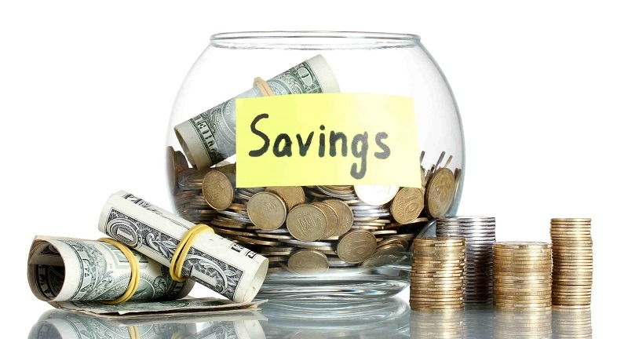
Different Types of Savings Accounts
Regular savings accounts
Greatest flexibility and freedom
Lower interest rates
Certificates of Deposit (CD)
Higher interest rates
Early withdrawal fees
Money market accounts
Higher interest rates
Higher maintaining balance, limited access to funds
ABLE accounts
Tax-exempt savings accounts for individuals with disabilities and their families
Make it possible for individuals with disabilities to save for the future without taking away their benefits

Slide 8

Retirement Plans & Investments
Employer-provided Retirement Plans
401(k)
403(b)
Pensions
SEP IRA, SIMPLE IRA
Individual Retirement Arrangements (IRAs)
Traditional
Roth
Deferred Annuities
Types of Investments:
Stocks
Bonds
Mutual funds
Savings accounts/CDs

Slide 9

Asset-Building
A way for individuals, families, and communities to gather a variety of resources and skills to help them move towards greater economic well-being.
Asset building strategies:
Financial education
Savings accounts
Healthy management of credit and debit
Tax credits and assistance with filing taxes
Accessing federal and state resources
Individual Development Accounts
What we have been doing in this course!

Slide 10
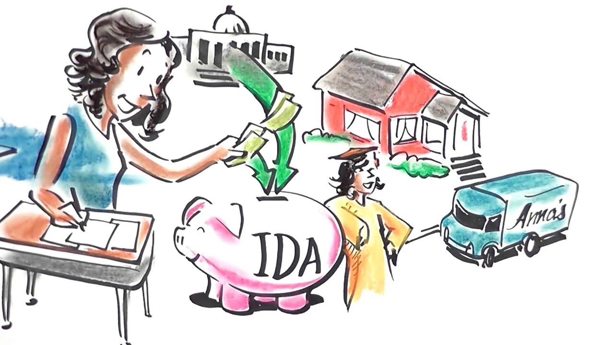
Individual Development Accounts
Special savings accounts that match the deposits of lower income people and families.
In addition to earning match dollars, individuals learn about budgeting and saving and receive additional training before they purchase an asset.
Savings go towards an asset-building purpose:
Education
Job training
Home purchase
Small business costs

Slide 11
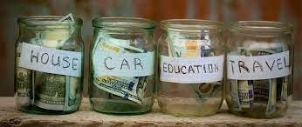
Saving Towards a Goal
Revisit your Financial Dream/Goal and Life One Year From Now PDP worksheets
Think about one or two goals (achievable purchases you’ve been thinking about or hoping for) that require you to save money

Slide 12
Money Saving Tips Revisited
Estimate the amount of money you are able to save each month using each of the money saving tips you’ve found useful the past few weeks.
Money Saving Tip | Money Saved Each Month
Using my SNAP card at the supermarket and farmers market. | $ 200
Cooking at home and making my own coffee instead of going out. | $ 100
Monthly Total: | $
How much can I expect to save after six months? | $
How much can I expect to save in one year? | $

Slide 13
How to Save Money on a Limited Income
Stick to your personalized, working budget
Use the money saving tips and the potential savings you identified
Goal: | Buy a bike
Timeline: | 6 months
Amount needed: | $300
How much do I need to save each month? | $50

Slide 14

Additional Saving Ideas:
Make saving money feel like a reward
Save your change every day. Keep it in a jar or container in your home or car.
Put small amounts at a time into savings. It’s usually much easier to put aside two or three dollars than larger sums of money.
Once it is set aside, don’t think about it, except how it applies toward your goal(s).
Put any extra income you generate into savings. Now could be a great time to open a savings account if you haven’t already!

Slide 15

Wrap-Up
Thank you all for your participation today!
Are there any questions?
Homework:
Choose one or more money saving ideas and commit to the idea(s). Keep track of which ideas are going well and which are not.
Commit to using your personalized budget for the next week.
Begin saving for your financial goal(s) by following your savings plan.

